Slide 1
Around the TABLE, AROUND the ROOM
DISCUSSION

Slide 2
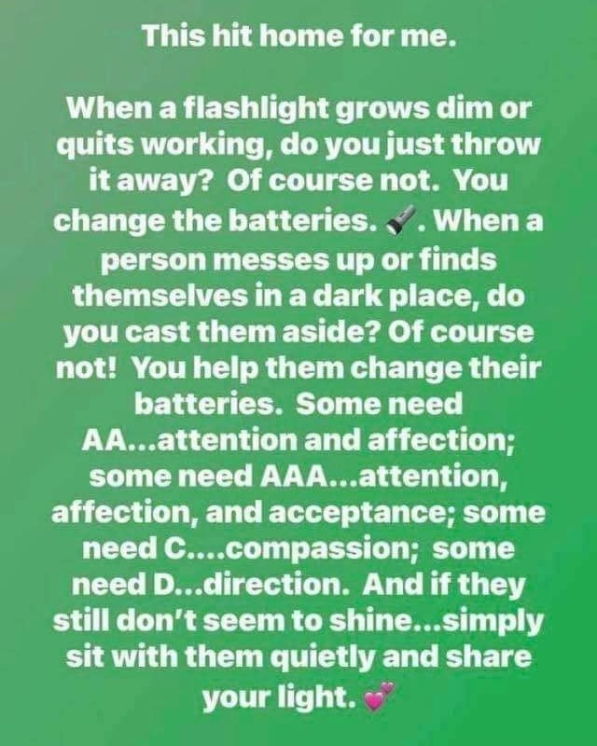
I posted this to our Facebook page this morning, and got several comments (including private messages regarding this):

Slide 3
Discussion starter
[Q] With or without names, whom do YOU consider to be a flashlight
in your life? What is it about them that brings light to your life?
[Q] What do you need from a flashlight?
[Q] What do YOU try to do to BE a flashlight in someone’s life?

Slide 4
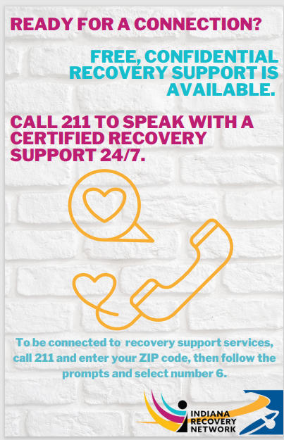
Free support services include:
recovery coaching sessions for those seeking or in recovery,
referrals to local resources, and
general support for family members
24/7 access by phone

