Slide 1
Around the TABLE, AROUND the ROOM
THIS WEEK
BELIEVE

Slide 2
Around the TABLE, AROUND the ROOM
[Q]: Why does our Brianna’s Hope shirts say “BELIEVE”?

Slide 3
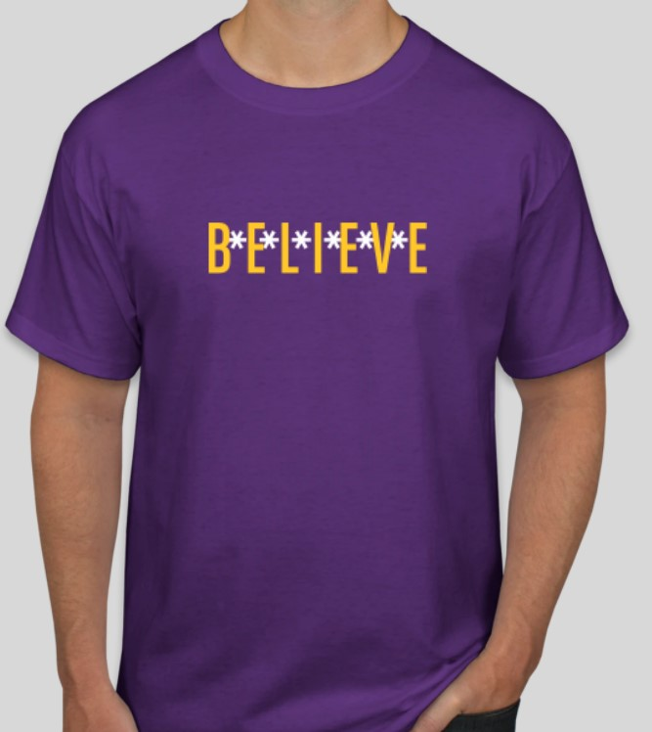

Slide 4
BELIEF always precedes BEHAVIOR. To change the way a person responds to life, change what a person believes about life.

Slide 5
BELIEF always precedes BEHAVIOR. To change the way a person responds to life, change what a person believes about life.
Perceived chaos creates anxiety.

Slide 6
BELIEF always precedes BEHAVIOR. To change the way a person responds to life, change what a person believes about life.
Perceived chaos creates anxiety. Perceived control creates calm.

Slide 7
BELIEF always precedes BEHAVIOR. To change the way a person responds to life, change what a person believes about life.
Perceived chaos creates anxiety. Perceived control creates calm. example: combat soldiers in WW II

Slide 8
Peace IS within reach--not for lack of problems, but because of faith in a sovereign God.
Rather than rehearse the chaos of the world, rejoice in the One who is in control.

